Slide 1
An industrial-strength­ audio search algorithm
Papers We Love, Montreal
July 26, 2017

Slide 2


Hello, I’m Tom

Slide 3


Slide 4
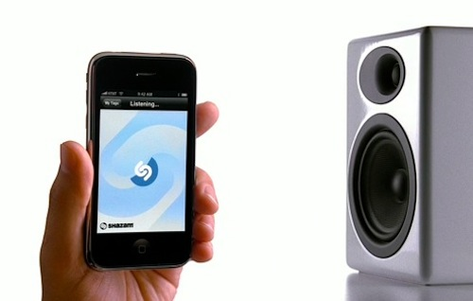

Slide 5
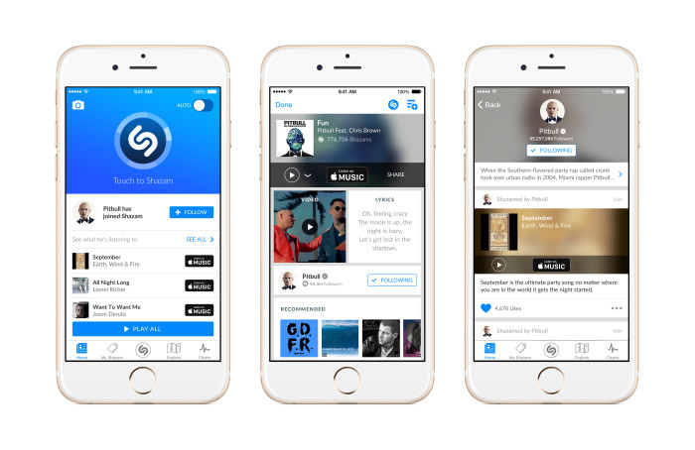

Slide 6
What is Shazam?
Identifies exact tracks of music.
Only needs small samples (seconds)
Robust to noise

Slide 7

What isn’t Shazam
Not designed to detect live recordings.

Slide 8

Shazam is old
Introduced in 1999!

Slide 9
Basic idea: audio fingerprinting
Audio source
Shazam App
Identified track
Sequence of integers
(frequency & timing)
Shazam Server
(database lookup)

Slide 10
Two key pieces to Shazam:
Construction of “fingerprints”
Contain frequency and timing information
Lookup of fingerprints

Slide 11
Part 1: Construction of the fingerprints

Slide 12
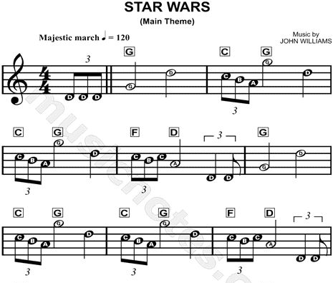
Spectrograms and Sheet music

Slide 13
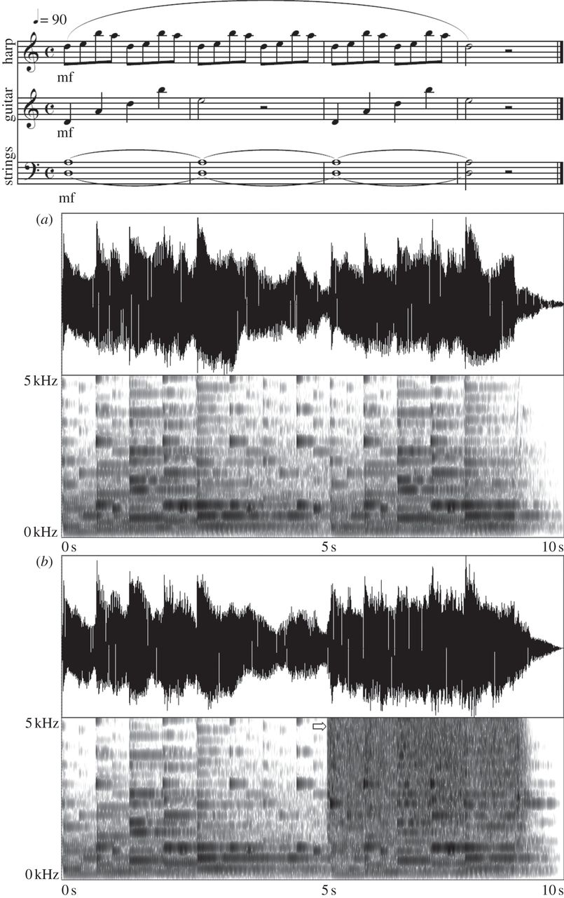
Spectrograms and Sheet music

Slide 14
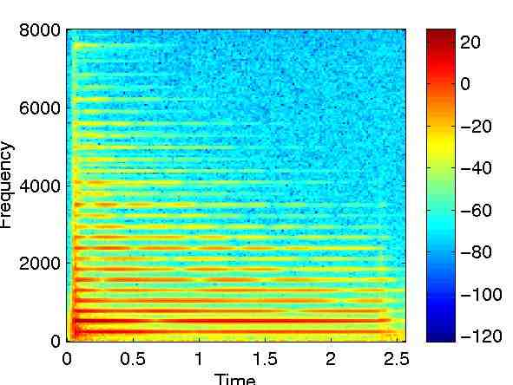
Piano C4 note (~260Hz fundamental freq)

Slide 15
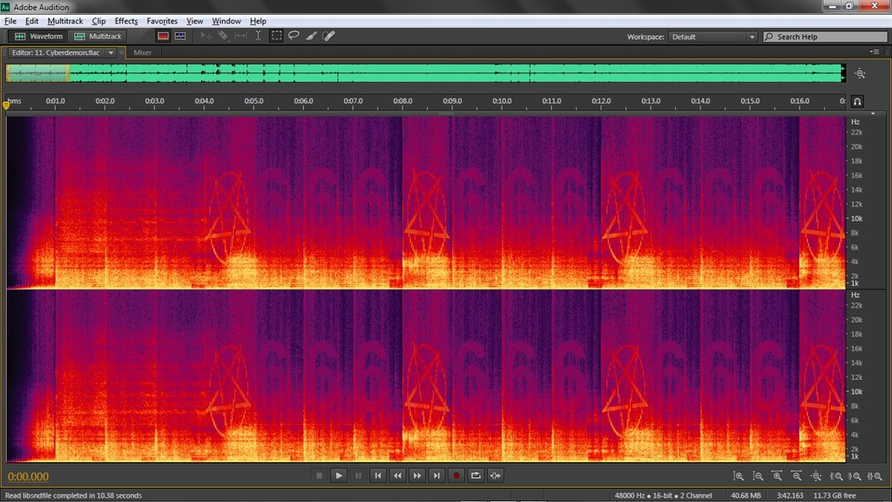

Slide 16
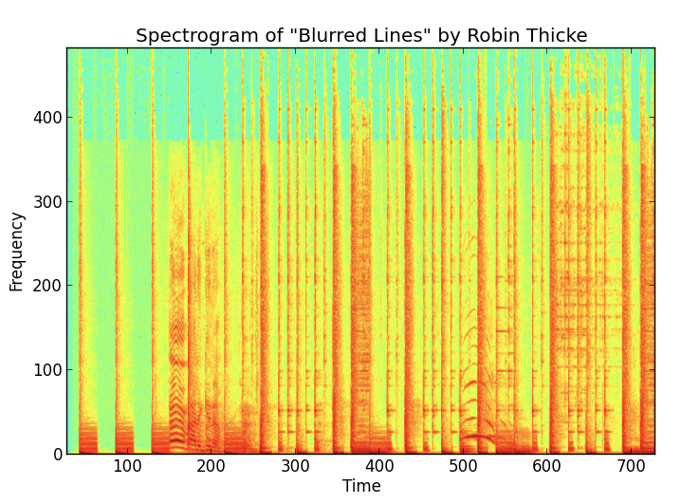
How to select interesting frequencies?

Slide 17
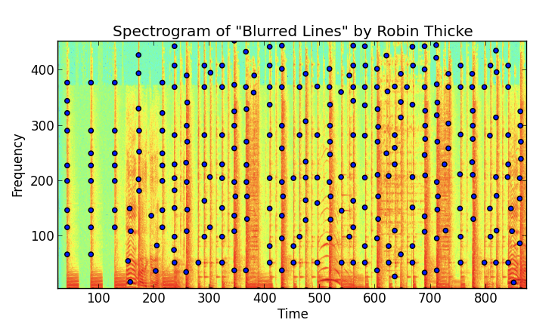
Peak detection
Extremely robust to noise
Highly reproducible

Slide 18
Open source implementation!
https://github.com/worldveil/dejavu
Uses scipy’s maximum_filter for peak detection.

Slide 19
Constructing the hashes 1: quantization
Frequencies are binned into 1024 values
=> We only need 10 bits to encode a quantized frequency.

Slide 20
Constructing the hashes 2: a wrong idea
What if we sent off the locations of the peaks?
In other words, send (quantized)
(time_offset, frequency)
What’s wrong with this?

Slide 21
Lookup on the database is the problem
We can’t key off the pair (time_offset, frequency): database would be enormous, and processing would be terrible.
Frequency alone leads to many prospective matches.

Slide 22
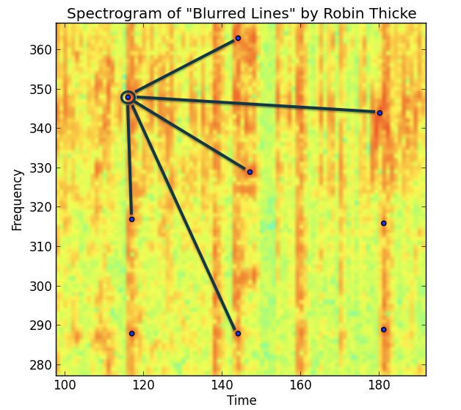
Shazam’s solution: look at frequency pairs
Anchor: (t0, f0)
Target: (t1, f1)
Hash is 32-bit integer of:
[10 bits f0,
10 bits f1,
10 bits (t1 - t0)]

Slide 23
Server side:
Only need a linear scan of each track to generate fingerprints

Slide 24
Part II: Looking up fingerprints

Slide 25
Server side: lookup
Incoming stream: h0:t0, h1:t1, h2:t2, …
(recall each hash = [freq0, freq1, time_delta])
Form buckets:
Song_xyz: h1:t1_xyz, h4:t4_xyz. h7:t7_xyz
Song_abc: h0:t0_abc, h1:t1_abc, h3:t3_abc, h5:t5_abc, h6:t6_abc
Song_123: h0:t0_123, h8:t8_123
Notes:
Go through sequence, explain what t0_abc means

Slide 26
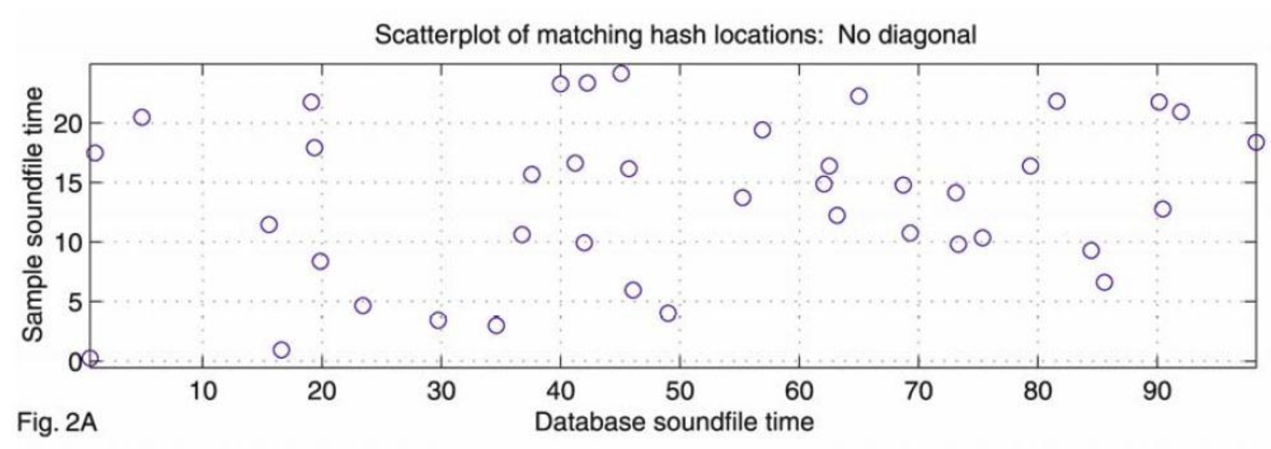
Server side: computing correlations
Bad match: many key matches but not time-aligned

Slide 27
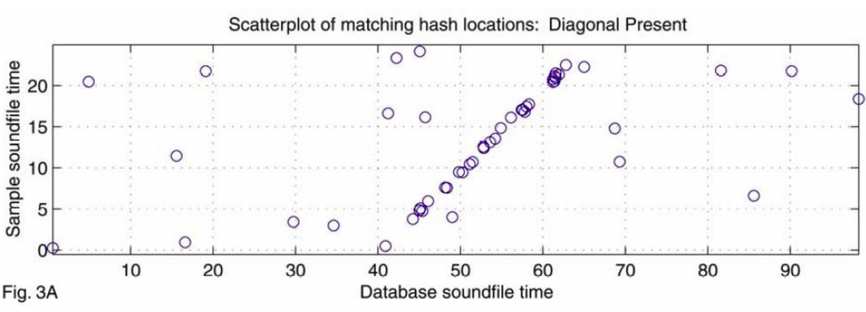
Server side: computing correlations
Good match: many are time-aligned

Slide 28
How does shazam measure correlations?
Could use robust regression, R^2 or whatnot (time complexity anyone?)
Much simpler approach: histograms (time complexity anyone?):
Denote { t_{i} } set of time offsets from sample, { t’_{i} } time offsets from database.
If from same song, t_{i} = t’_{i} + c for some constant c.
Form histograms of { t_{i} - t’_{i} } and look for peaks.

Slide 29
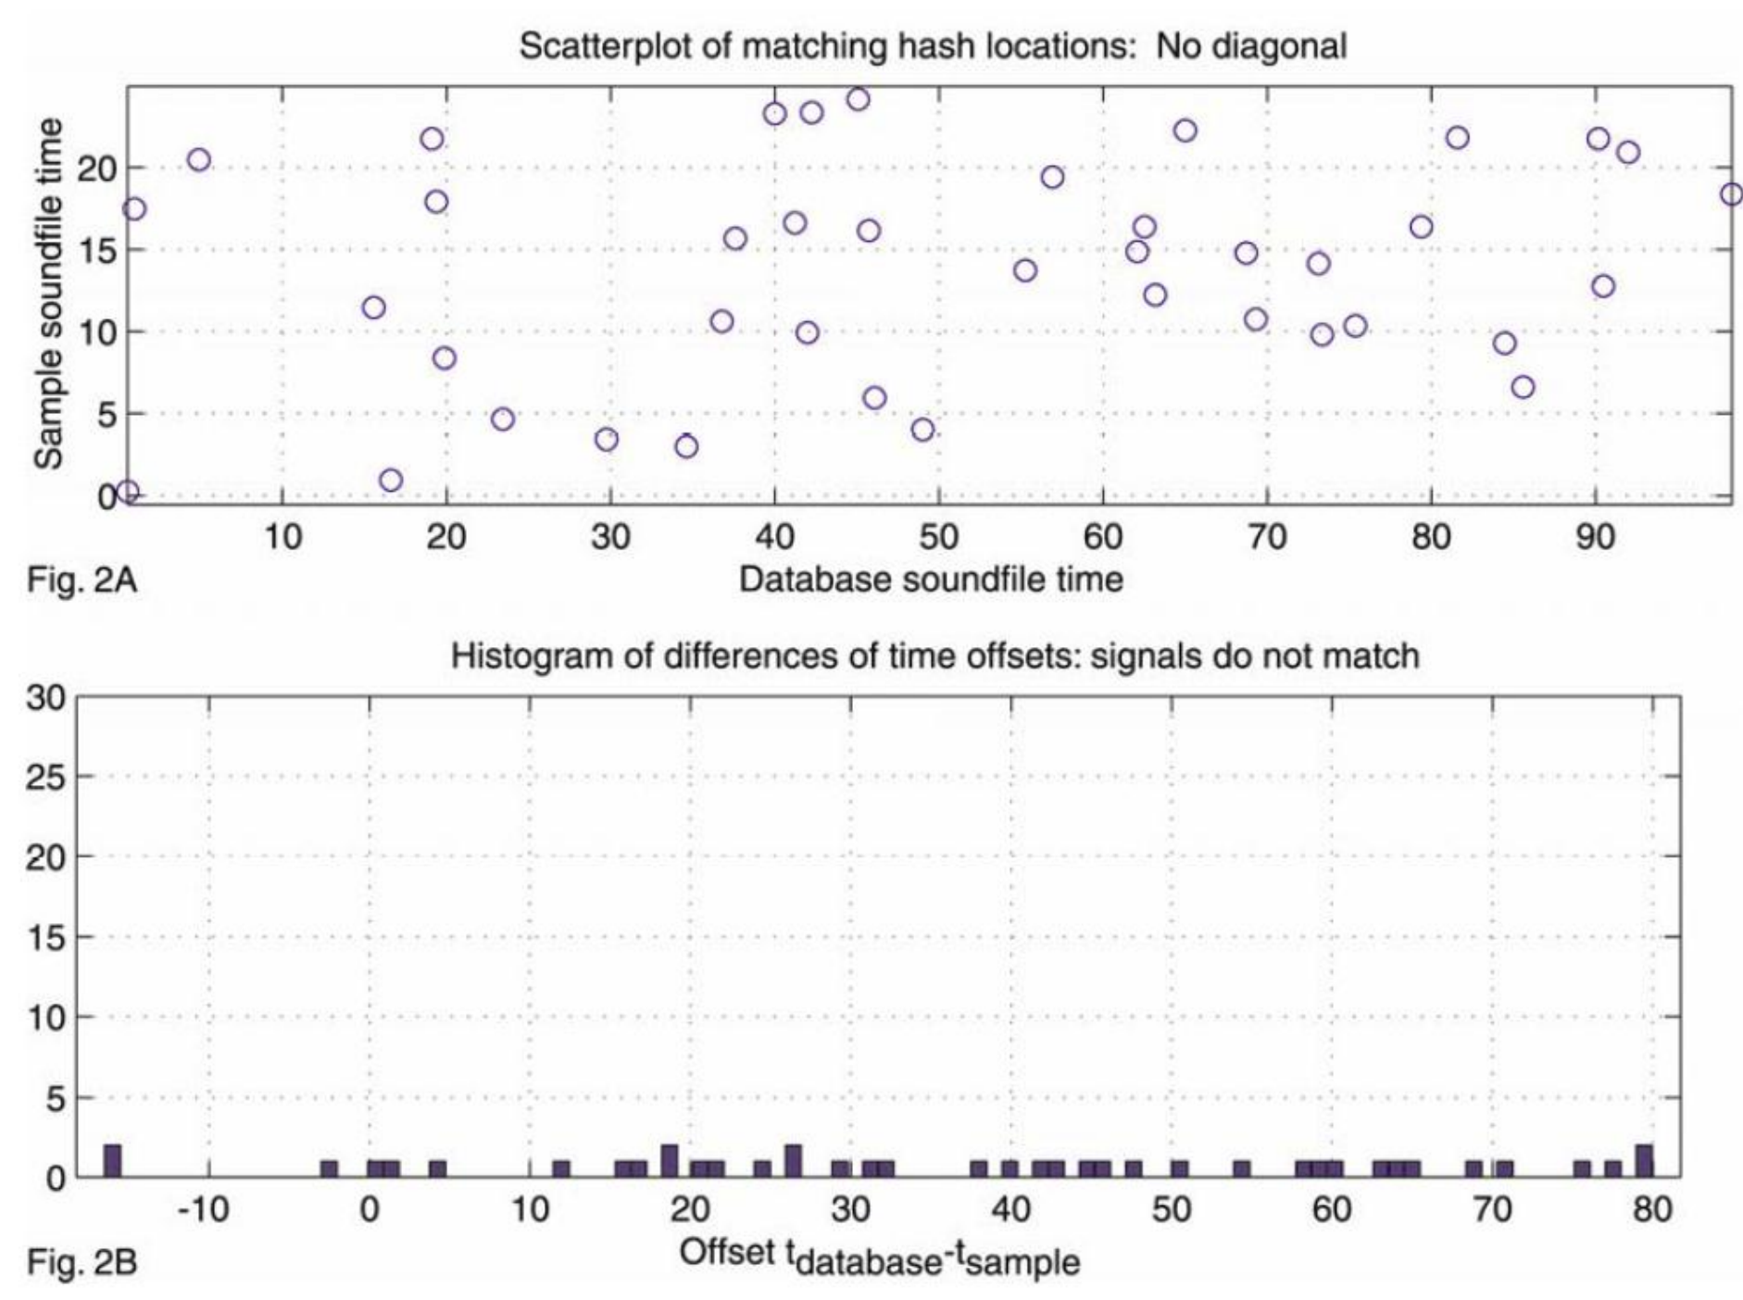

Slide 30
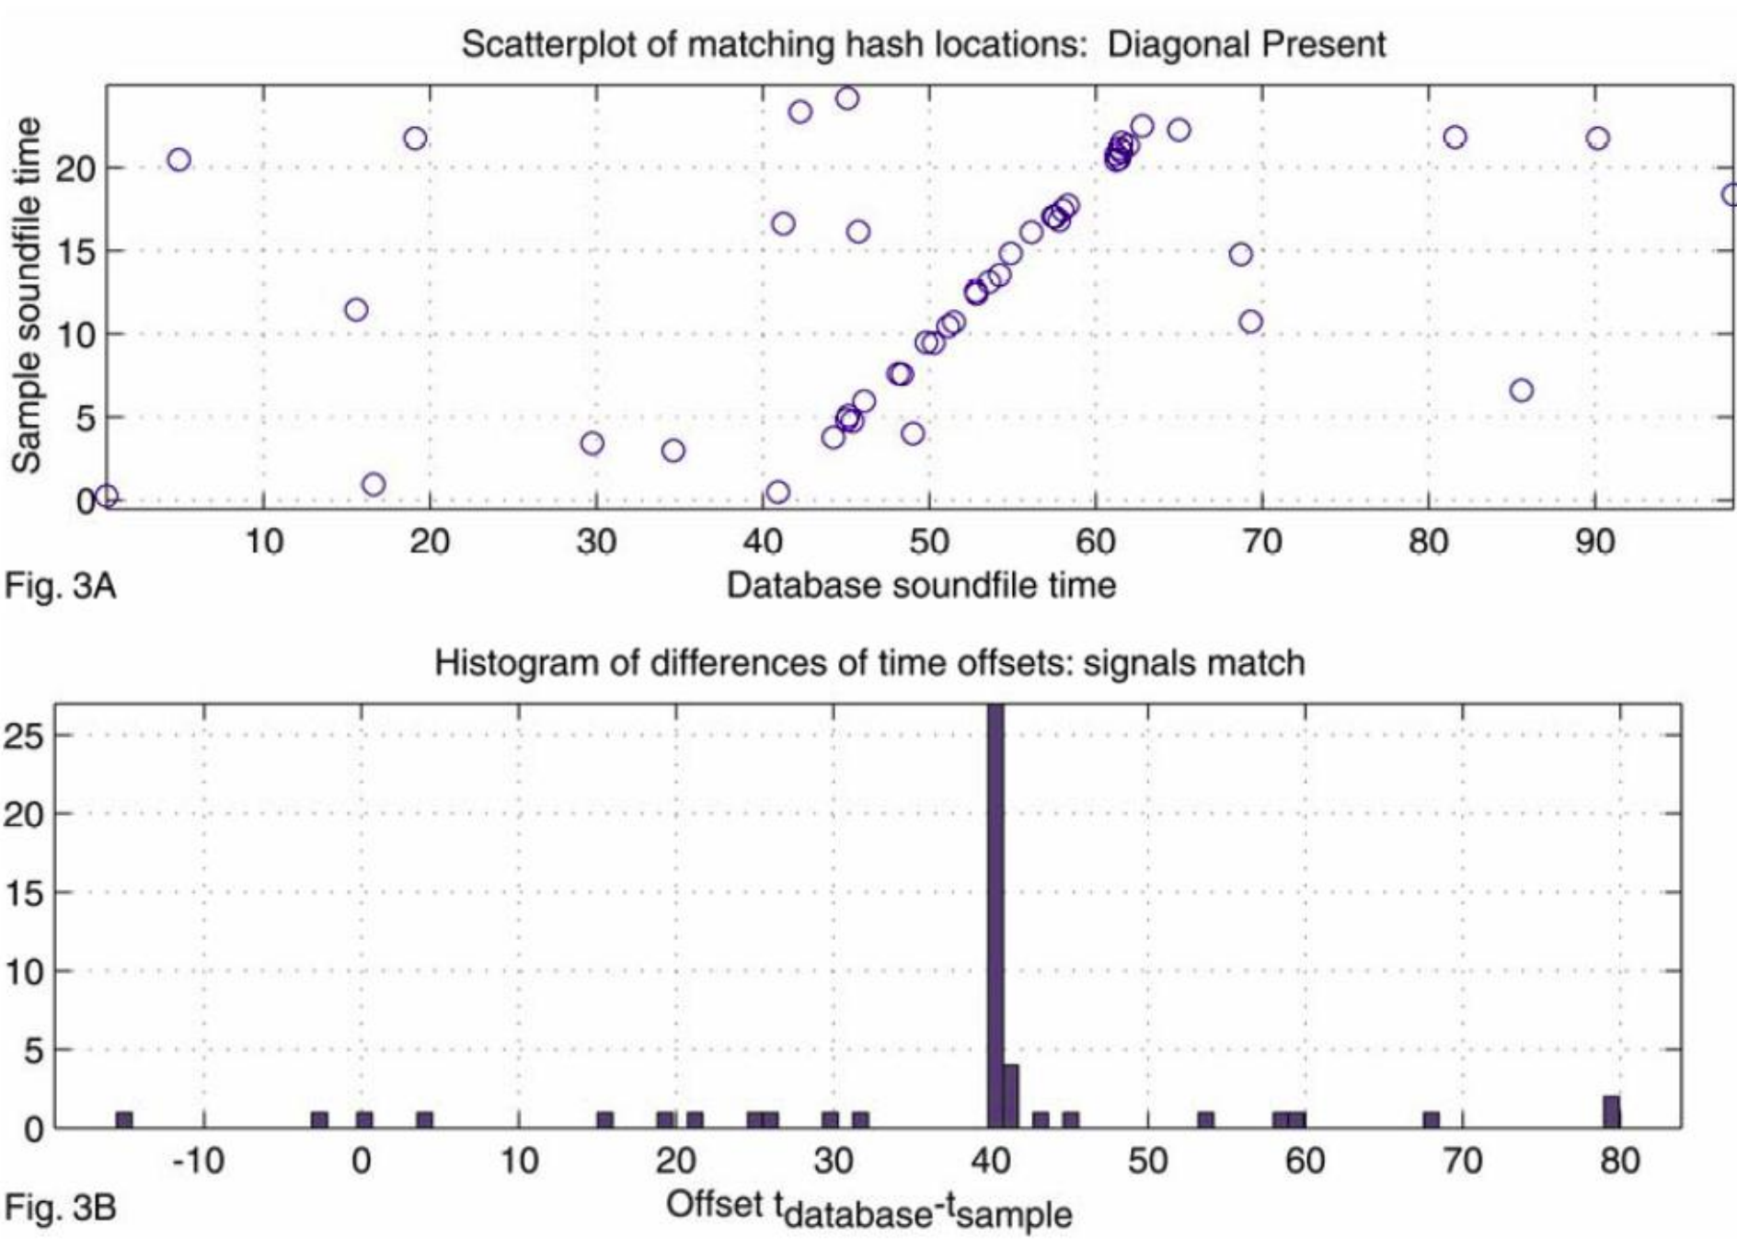

Slide 31
Questions? Thank you!
thomas.d.peters@gmail.com
“An industrial-strength audio search algorithm”, by Avery Li-chun Wang. Proceedings of the 4 th International Conference on Music Information Retrieval
https://github.com/worldveil/dejavu

